Slide 1



EMPLOYEE TURNOVER ANALYSIS
Idris Mahamat
2025MIS637-WZ

Slide 2
Agenda
Introduction
Exploratory Data Analysis
Dataset description
Bar chart
Histogram
Modeling
Model performance
Implementation
Summary

Slide 3

Introduction
Employee turnover analysis is an HR analysis that involves collecting data, analyzing and reporting HR data to help understand the company’s turnover rate. In our use case, we will study the dataset name “data_generated” which was randomly generated from mackaroo.com.
The implementation of this use case will be as follow : first we are going to conduct a basic data exploratory analysis, then build different machine learning models, compare each model’s performance and finally choose the model with the highest accuracy.
Source : Quit Work Stock Photos, Images and Backgrounds for Free Download

Slide 4

- Find out the reason that employee is resigning from the company. - Determine the key factor that led to the turnover.
.
Employee turnover analysis

Slide 5
Exploratory Data Analysis
Bar chart
Histogram
min, max, mean, mode
Standard deviation
Quartiles

Slide 6
Dataset description
Satisfaction_Score | Realised_Project | Performance_Score | Work_accident | Promotion_History | Department
Numerical (0-10) | Numerical (1-10) | Numerical (0-10) | Numerical (1-0) True= 1 False = 0 | Numerical (1-0) True= 1 False = 0 | Categorical
Montly_Hours | Tenure | Employment_status | Job_level | Bonus | Salary
Numerical (96-320) | Numerical (0-10) | Numerical (0-1) True= 1 False = 0 | Categorical | Numerical (0-1) True= 1 False = 0 | Categorical

Slide 7
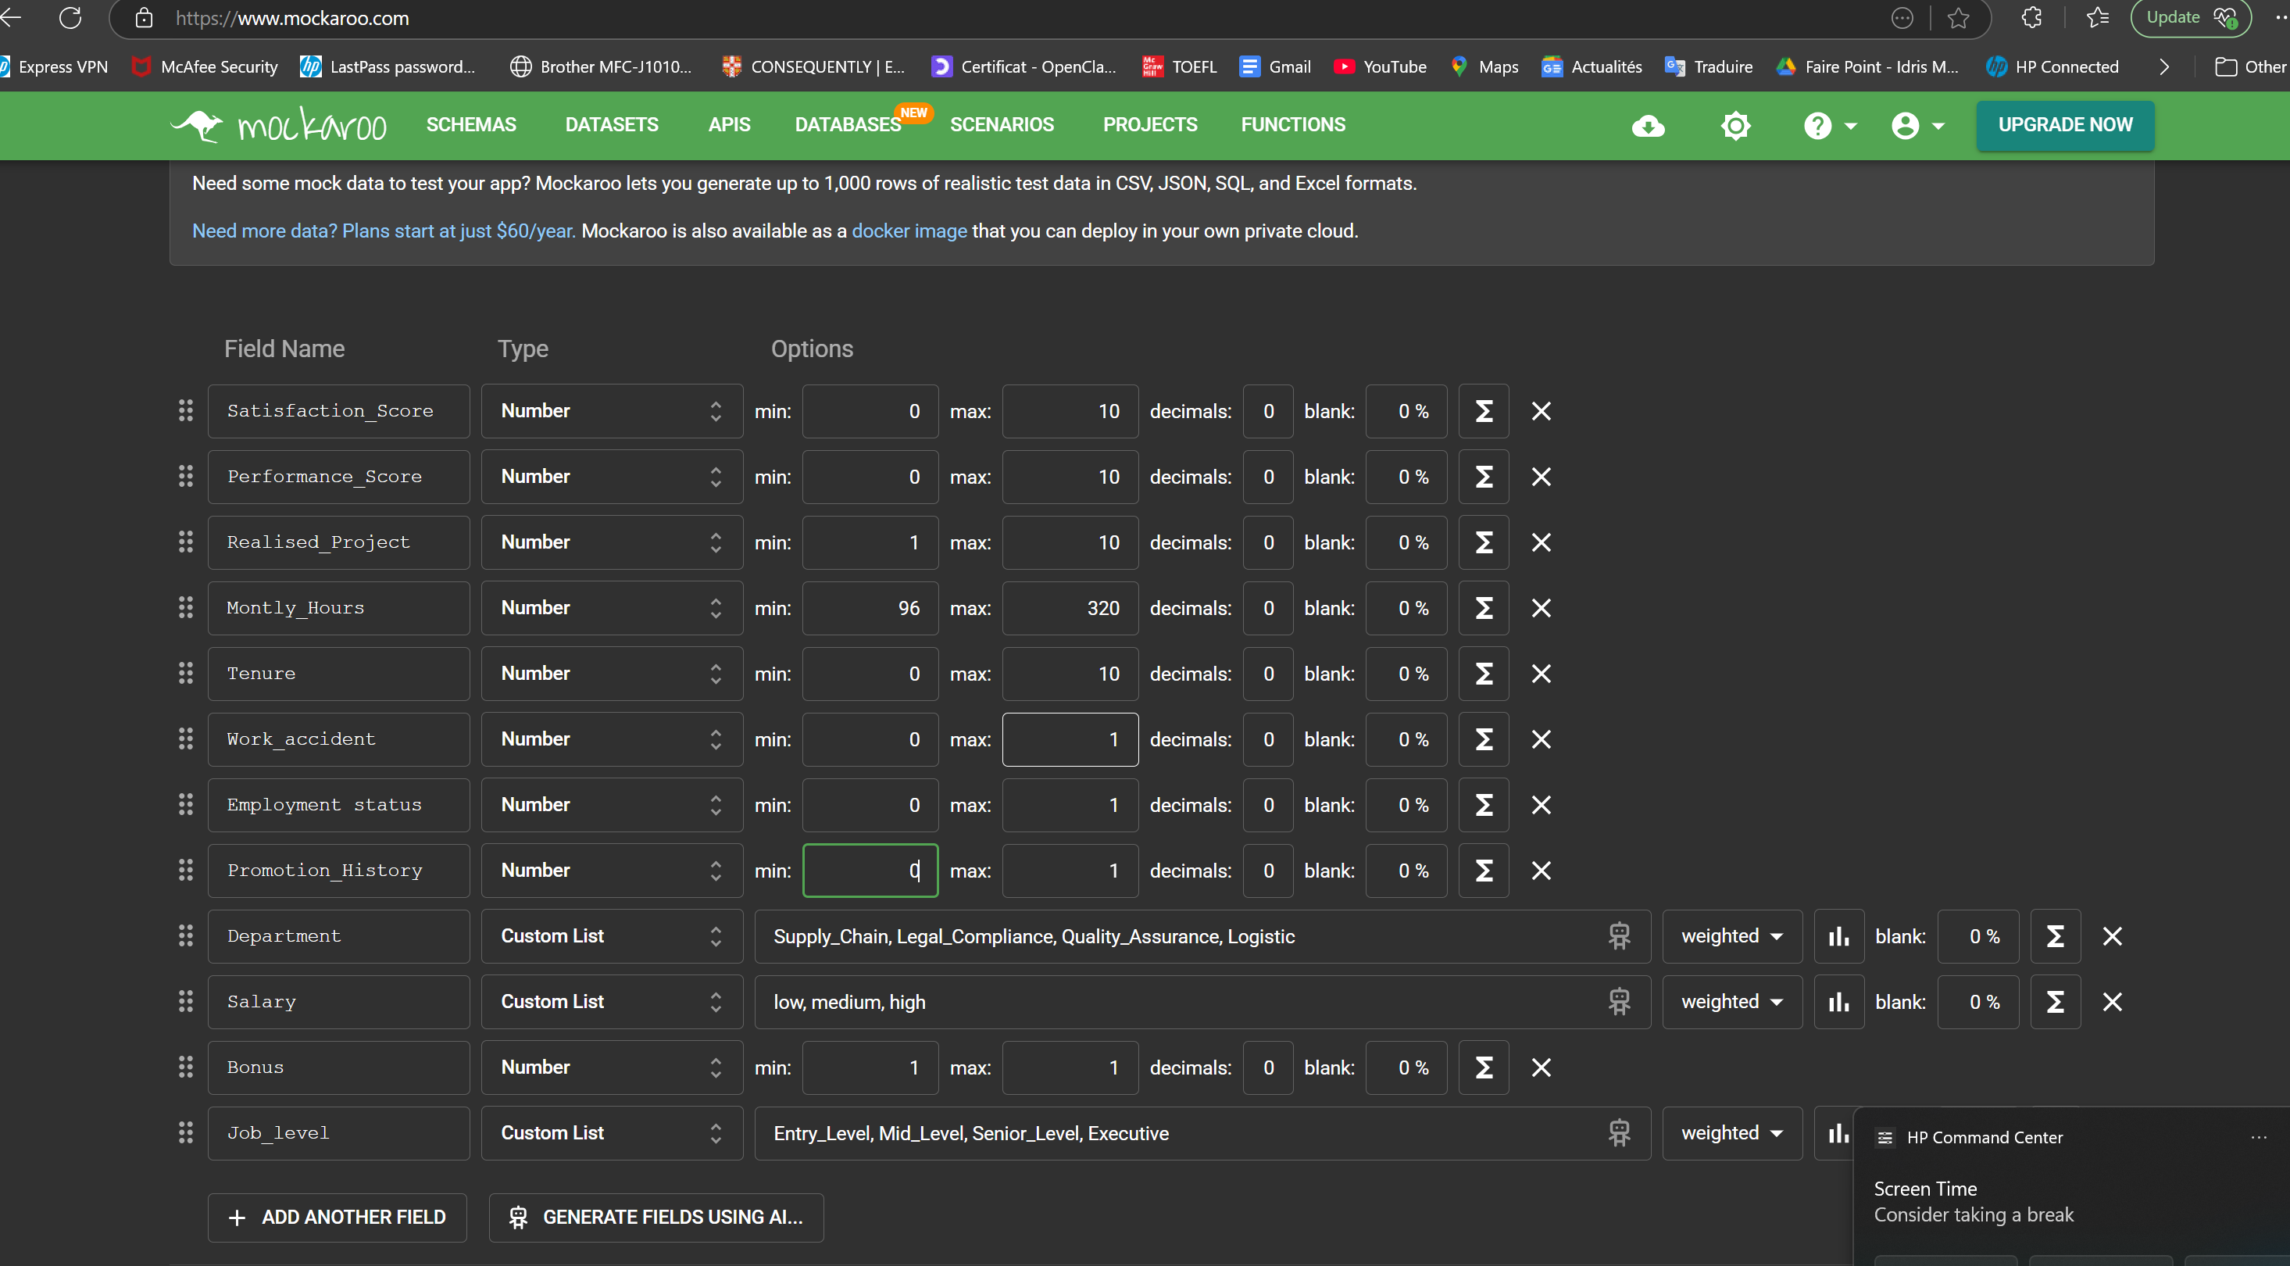

Slide 8
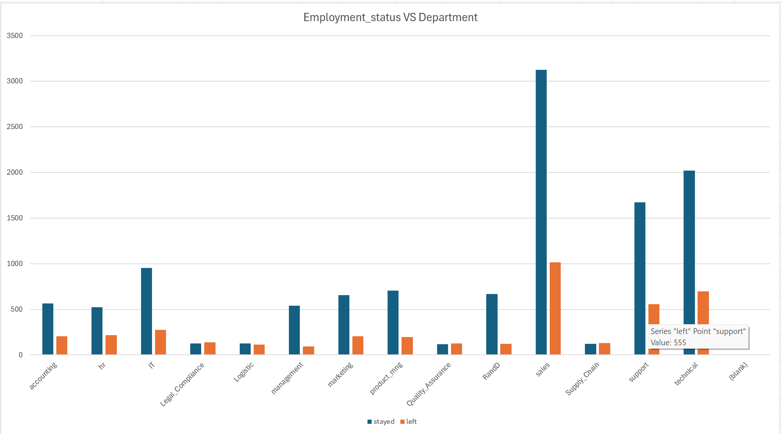
Bar chart

Slide 9
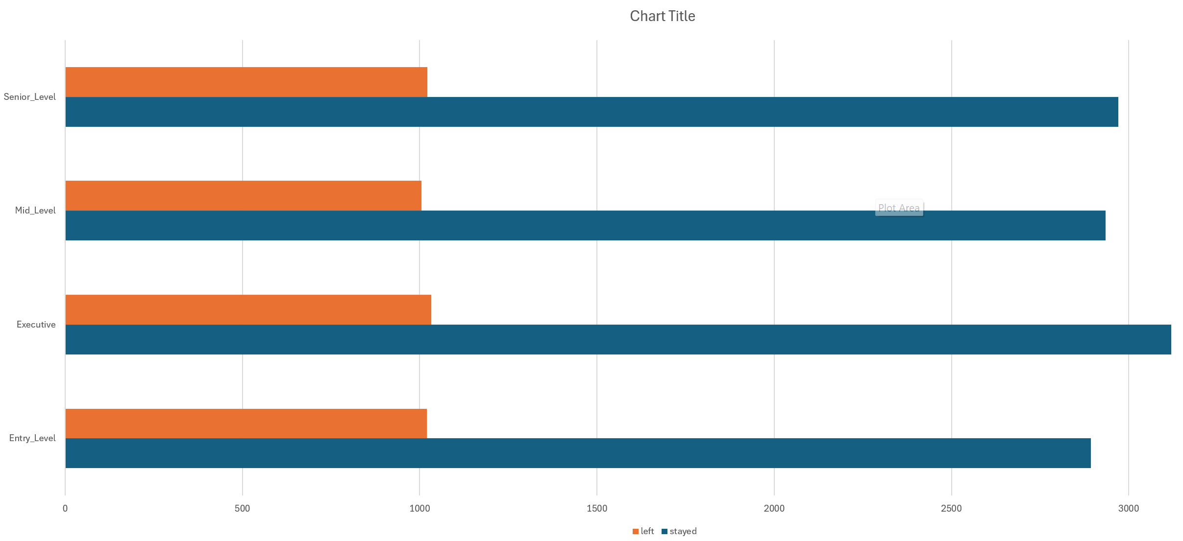

Slide 10
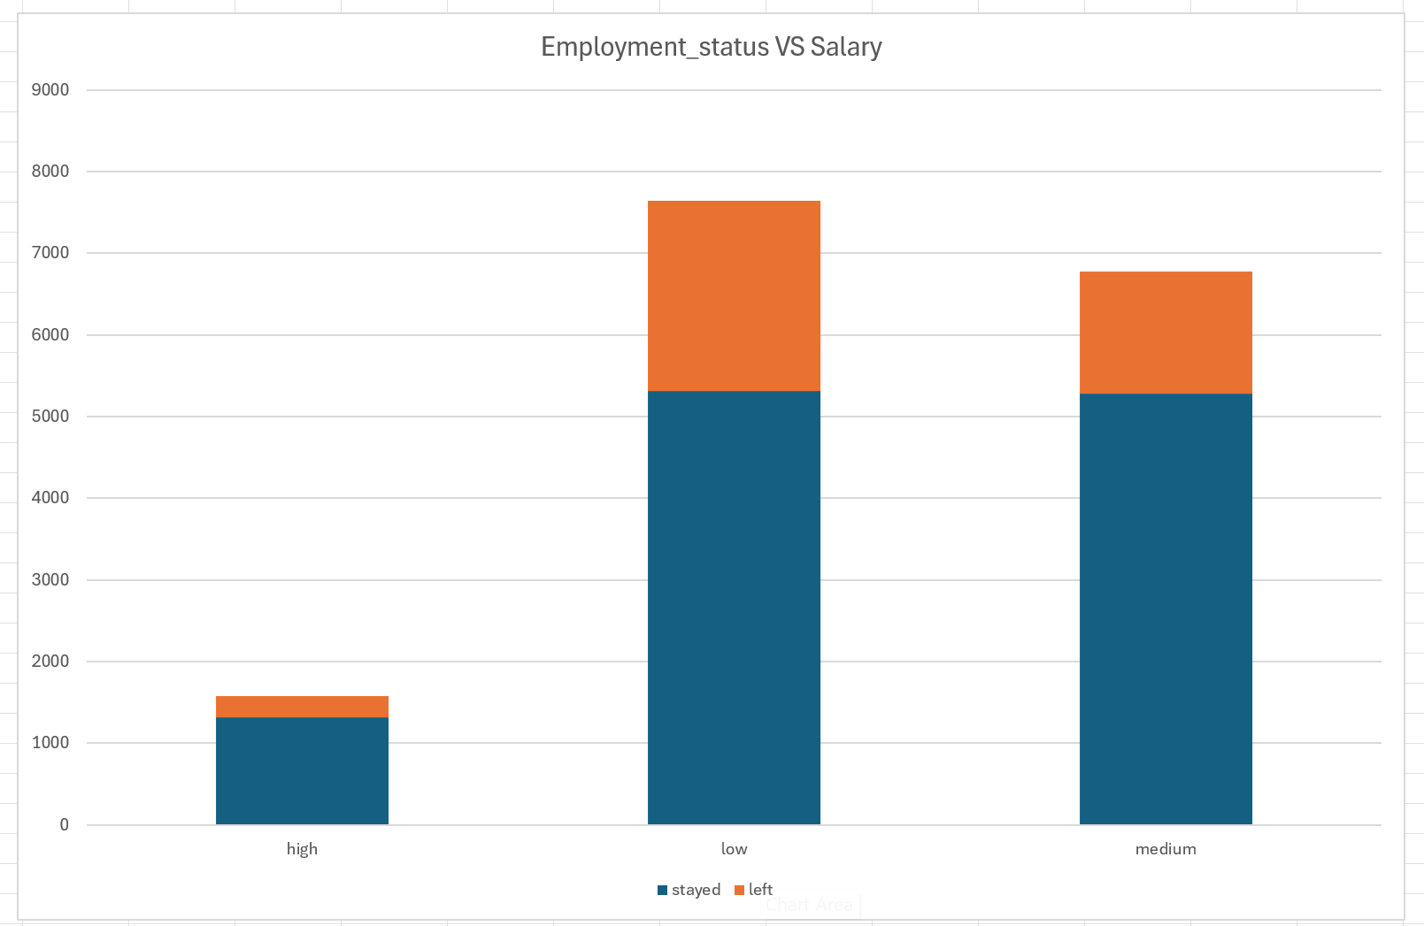

Slide 11
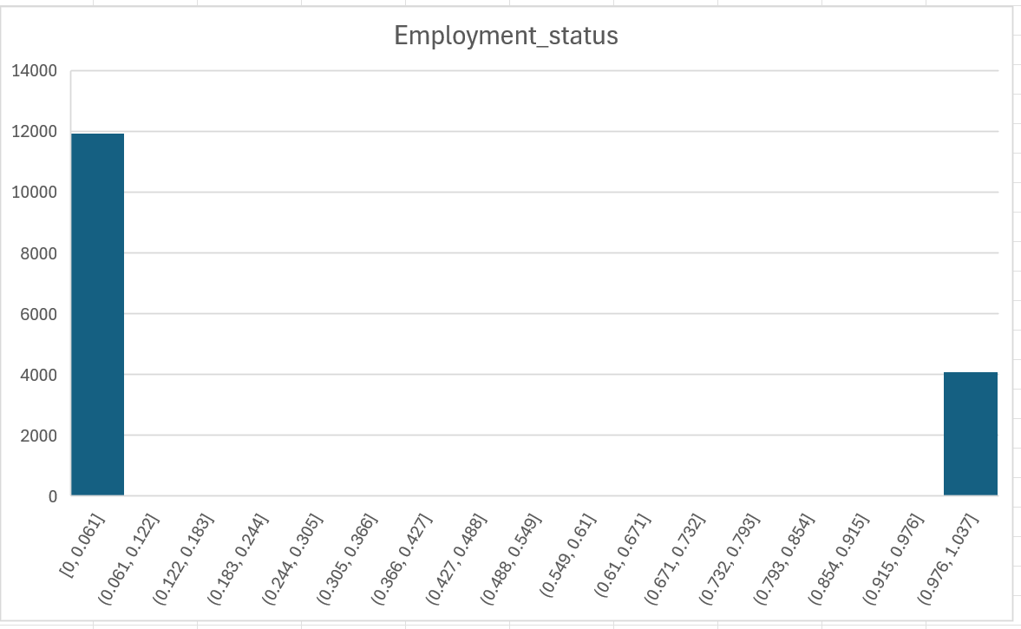
Histogram

Slide 12
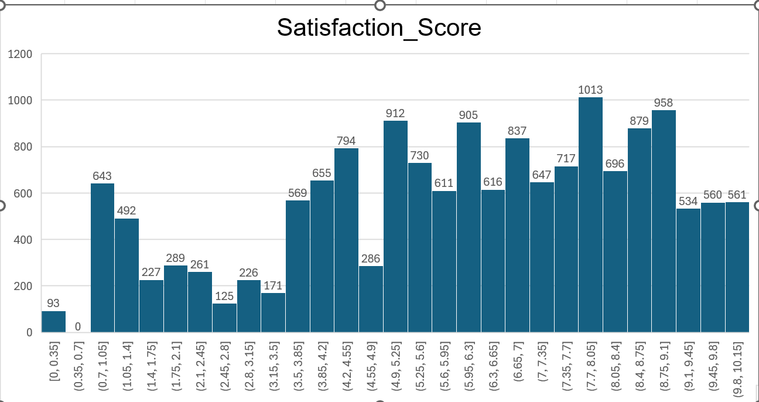
Histogram

Slide 13

Modeling
Source : https://cdn.pixabay.com/photo/2019/04/15/12/09/machine-learning-4129175_960_720.jpg
Employee turnover analysis

Slide 14
Model
Supervised
CART
clustering
KNN
Random Forest
Classicafication And Regression Tree
K-means
Vice-Président du marketing
K-Nearest Neighbor
Multiple tree
Unsupervised

Slide 15
Model Performance
Precision
Recall
F1 Score
accuracy

Slide 16

Implementation

Slide 17
Model measurement - test = 30%
model | Precision [0 – 1] | Recall [0 – 1] | F1-score [0 – 1] | accuracy | Support [0 – 1]
KNN (K = 2) | 0.95 – 0.85 | 0.95 – 0.84 | 0.95 – 0.84 | 0.92 | 3593 - 1207
CART | 0.96 – 0.88 | 0.96 – 0.90 | 0.96 – 0.89 | 0.94 | 3593 - 1207
RANDOM FOREST | 0.95 – 0.94 | 0.98 – 0.86 | 0.97 – 0.90 | 0.95 | 3593 - 1207
 |  |  |  |  | 4800
K_MEAN
Out of all model we tested so far, random forest has the highest accuracy score about 95% and F1 scrore which is better than KNN, CART. So, we will choose random forest for our project.

Slide 18
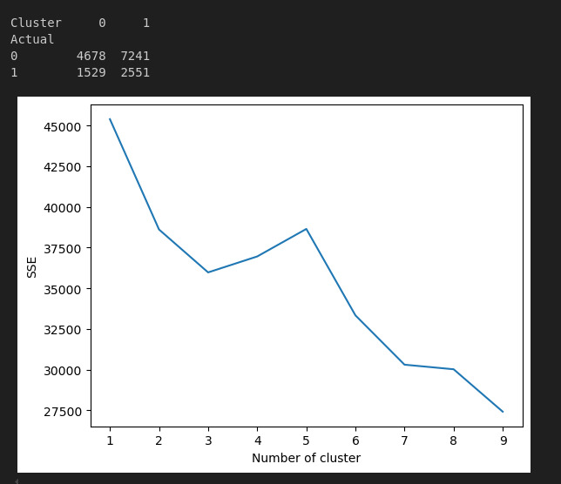

Slide 19

Summary
According to the model, the key feature which determine an employee turnover in our use case is SATISFACTION. From that we understand that the chance of an employee to leave is unlikely if he his satisfied with his job.

Slide 20
references
Mockaroo - Random Data Generator and API Mocking Tool | JSON / CSV / SQL / Excel
Quit Work Stock Photos, Images and Backgrounds for Free Download
Employee Turnover Data Analysis: 8 Tips for Success – AIHR
DeepSeek - Into the Unknown
https://cdn.computerhoy.com/sites/navi.axelspringer.es/public/media/image/2023/04/raspberry-lanza-editor-codigo-aprender-python-lenguaje-ia-3008158.jpg
https://d3srxiunz7lgh6.cloudfront.net/nhrdh8t9d2rox4ezsizzhyvm1y5l

Slide 21



Merci
Idris Mahamat

